Slide 1
Drowsiness Detection System
Group Members:-
Patel Het (2021csb1119)
Nikhil Garg(2021csb1113)
Priyanshu Kumar(2021csb1125)
Khushboo Gupta(2021csb1105)
Nandini Mundhra (2021csb1113)
Kushagra Sharma(2021csb1107)

Slide 2
Introduction
In this presentation , we are gonna explain about the project we have made - Drowsiness Detection System.
In this , we have build a prototype of Drowsiness Detection and Alerting System for Drivers using Arduino , Eye blink Sensor, and Buzzer.
The basic purpose of this system is to track the driver’s eye movements using Eye blink Sensor and if the driver is feeling drowsy, then the system will trigger a warning message using a loud buzzer alert.
The eye blink sensor of the system senses the blink rate. If the eyes are found to be closed, then the buzzer buzzes and this alerts the driver eventually.
These sensors are interfaced with Arduino UNO by the help of a program which make it happen.

Slide 3
Why do we need this?
A countless number of people drive on the highway day and night. Taxi drivers, bus drivers, truck drivers and people traveling long-distance suffer from lack of sleep. Due to which it becomes very dangerous to drive when feeling sleepy.
The majority of accidents happen due to the drowsiness of the driver. So, to prevent these accidents ,this type of system is very essential.
This system alerts the driver whenever he is getting into sleep while driving the vehicle. since sleeping on wheels is dangerous sometimes it may converts into fatal accidents which can lead to death.
So to prevent such consequences of accident we can use this gadget to alert the driver when he feels drowsiness

Slide 4
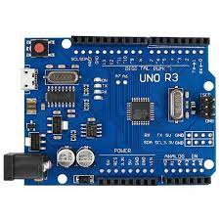
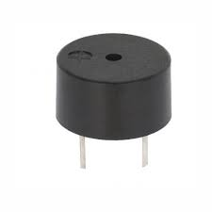
Components Required
Ardunio The Arduino Uno is an open-source microcontroller board based on the Microchip ATmega328P microcontroller and developed by Arduino.cc and initially released in 2010. The board is equipped with sets of digital and analog input/output (I/O) pins that may be interfaced to various expansion boards (shields) and other circuits.Here , we are using this to interface eye blink sensor with a program which is used for drowsiness detection.
Buzzer A buzzer or beeper is an audio signaling device,which may be mechanical, electromechanical, or piezoelectric (piezo for short). Typical uses of buzzers and beepers include alarm devices, timers, train and confirmation of user input such as a mouse click or keystroke. Here, we are using this to alert the driver by its sound whenever our system detects him/her drowsy.

Slide 5
Components Required
3. Eye blink sensor
The eye blink sensor is used to detect the eye blinks and using which we can also detect the activities like the Drowsiness of the driver while driving.It works by illuminating the eye and eyelid area with infrared light, then monitoring the changes in the reflected light using a phototransistor and differentiator circuit. It contains an Infrared transmitter and Receiver LED which is used to detect the eye blink.The exact functionality depends greatly on the positioning and aiming of the emitter and detector with respect to the eye.
The working of this project is based on an Infra Red (Eye blink) Sensor.
This sensor is the heart of this project.
The sensor sensitivity is set to minimum.

Slide 6
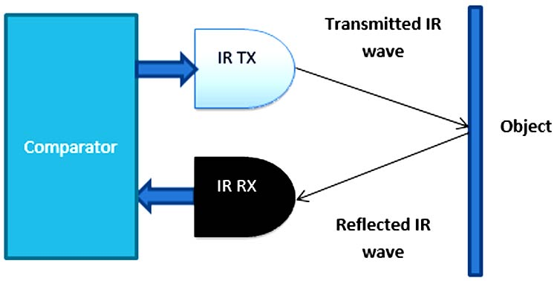
Components Required
Infrared sensors consist of two elements: an infrared transmitter which acts as the source, and infrared receiver which acts as the receiver. Infrared sources include an IR LED and Infrared detectors include photodiodes. The energy emitted by the infrared source is reflected by an object and falls back on the infrared detector. When the light emitted by the IR LED falls on the receiver, the resistance of the photodiode falls down significantly. This photoreceiver is connected with a potentiometer to form a voltage divider circuit, which gives a variable analog output when blinking activity is detected.
When the incident radiation is more on the photodiode, the voltage drop across the series resistor/Potentiometer will be high. In the Comparator IC which is nothing but Operational Amplifiers, or Op-amps, both the reference analog voltage and the actual output voltages are compared. If the voltage across the resistor series to the photodiode is greater than that of the reference voltage, the output of the comparator is high, else Low. As the output of the comparator is connected to an LED, it glows when the sensor detects some activity such as eye blinking. The threshold voltage can be adjusted by adjusting the potentiometer depending on the environmental conditions.

Slide 7
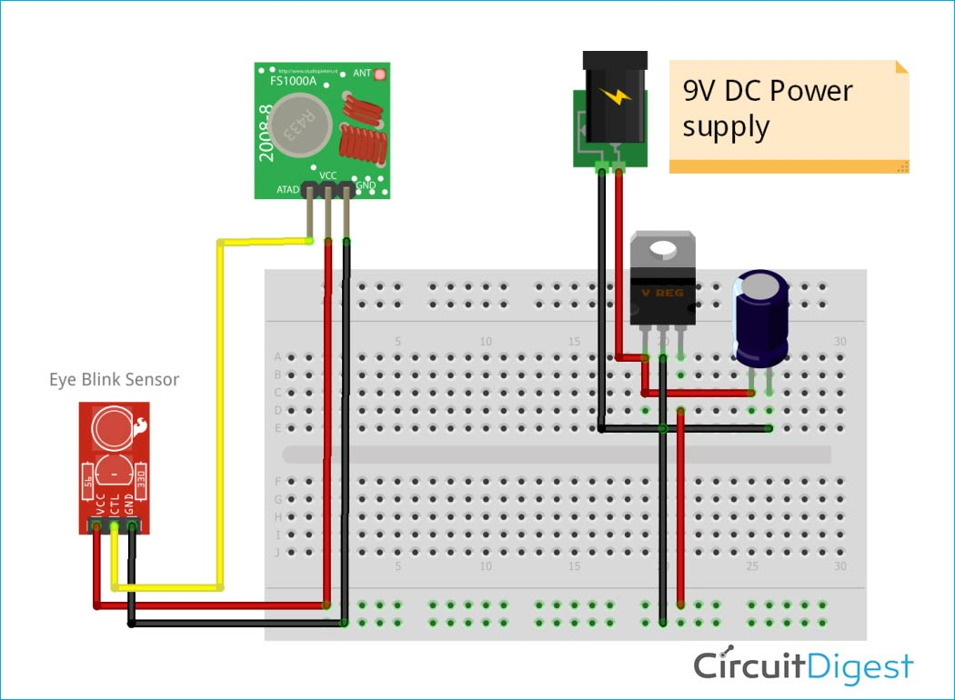
Principal of Model
Our detection system mainly consist of two sections:
Transmitter section -The transmitter section consists of an RF Transmitter and Eye Blink Sensor. As shown in the figure, first the 9V DC battery is stepped down to 5V DC using a 7805 voltage regulator, and then the 5V DC supply is given to the Eye Blink Sensor and RF Transmitter. The output pin of the eye blink sensor is fed to the RF transmitter to transmit it wirelessly to the receiver end.

Slide 8
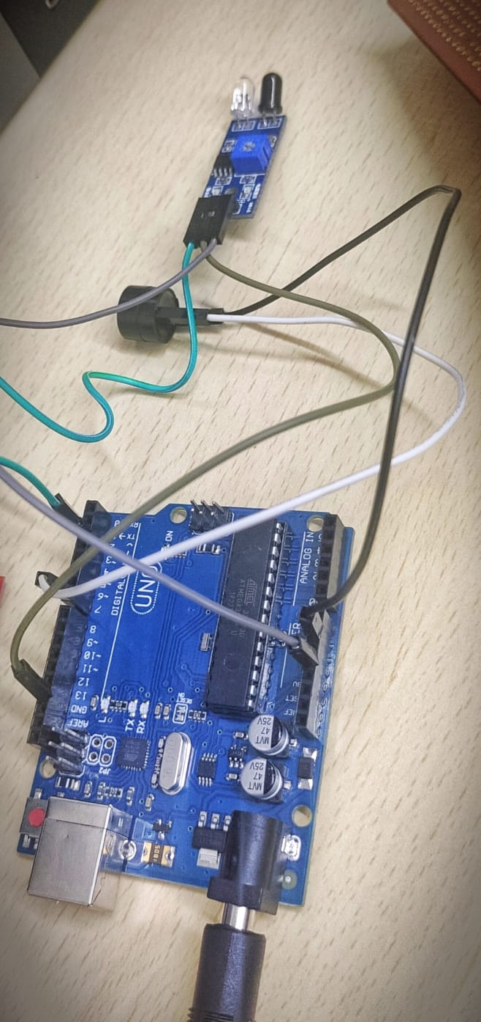
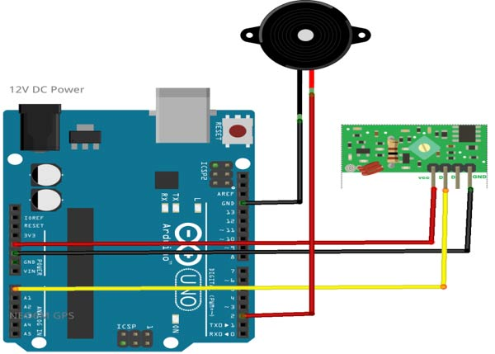
Principal of Model
2. Receiver Section- The Receiver side uses Arduino Uno with RF receiver for data processing. As shown in the figure, on the receiver side the RF receiver is connected to a 5V DC power supply from Arduino. The Arduino is powered from a 9V DC power supply externally. The output of the RF receiver is fed to the Arduino Analog pin.
The Buzzer is connected to the Digital pin of Arduino as shown.

Slide 9
Main construction
We connected a IR sensor to the Arduino board as Vcc of the sensor to the vcc of the Arduino uno, Ground to the ground and the output of the sensor to the Analog pin one (A1) of the Arduino Pro Mini.
We used a 5 volt buzzer for alerting. We connected buzzer to ardunio pins and interface it to ardunio through our program to buzz when there is eye blinking. Transistor's emitter connected to the ground and collector connected to the negative pin of the buzzer and vibrator motor. Positive terminal of buzzer are further connected to the vcc of the Arduino Board. Base of the buzzer connected to the pin D3 of the Arduino uno.
Here We have used a PCB for making the circuit, to solder all the components and then finally connecting it to glasses. We stick the sensor over the Arduino board using hot glue and solder it with short flexible wires. After next to it, We made a buzzer unit, in which the buzzer and battery is included, which we mount on the left stick of glasses near ear.
All these after soldering on the PCB are mounted on the left stick of the glasses by hot glue.
Also, the sensor is sticked to the frame such as it will remain close to the eye.the distance between the eye and the sensor will not more than 15 to 20mm.

Slide 10
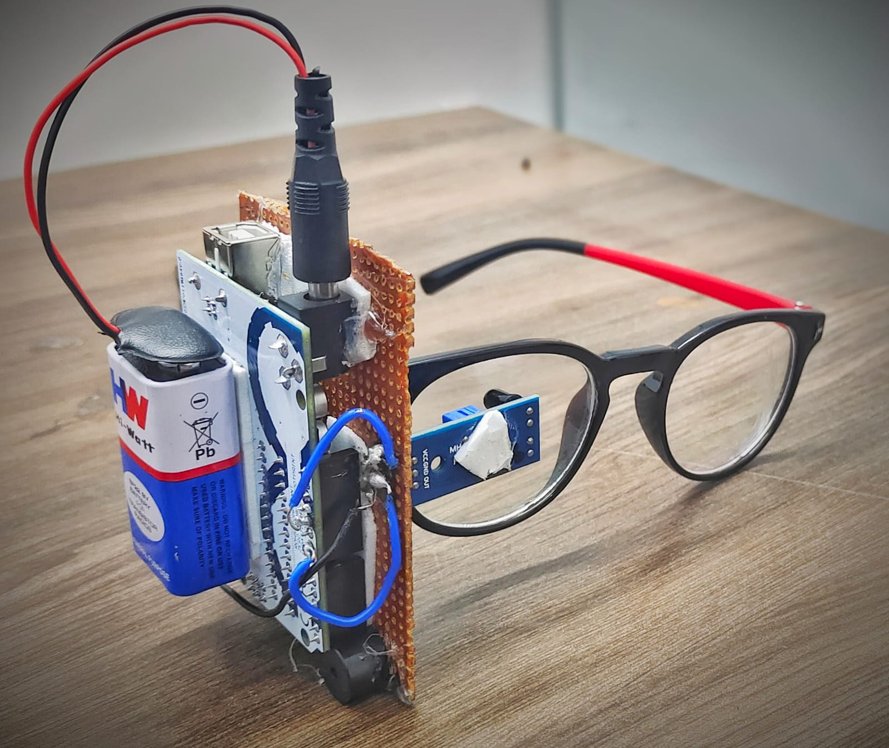
Main Construction
After soldering and sticking all the components on frame, our drowsiness detection system is ready and these are some pics.
After connecting all the components After a successful hardware connection for both the transmitter side and receiver side, we have uploaded the code to Arduino uno that is connected to the receiver side.

Slide 11
How it works
When we wear the glasses and keep our eyes open , the photodiode inside the sensor doesnot receive any reflected IR waves and thus remains deactivated.
When we keep blinking at some fixed interval ( more than 2 seconds according to our code),the IR waves emitting from LED got reflected by the skin , and the photodiode inside the senor receive reflected IR waves and thus got activated.
Upon detection of eye blinking , buzzer make sound.

Slide 12
Thank you….

